Slide 1
Mitron Bank Product Strategy – Codebasics Project
By
Lakshmi Narashimman. D

Slide 2
Problem Statement
Mitron Bank is a legacy financial institution headquartered in Hyderabad. They want to introduce a new line of credit cards, aiming to broaden its product offerings and reach in the financial market.
AtliQ Data Services came to know about this through an internal link and approached Mitron Bank with a proposal to implement this project. However, the strategy director of Mitron Bank, Mr. Bashnir Rover is skeptical and asked them to do a pilot project with the sample data before handing over them the full project. They provided a sample dataset of 4000 customers across five cities on their online spending and other details.
Peter Pandey is a data analyst at AtliQ Data Services and was asked by his manager to take over this project. His role is to analyse the provided sample data and report key findings to the strategy team of Mitron Bank. This analysis is expected to guide them in tailoring the credit cards to customer needs and market trends.
The successful acquisition of this project depends on Peter's ability to provide actionable, data-driven recommendations and impress Mr. Bashnir Rover & his team. Peter requested support from his manager Tony Sharma, and he provided him with some ideas to generate insights based on the data provided.

Slide 3
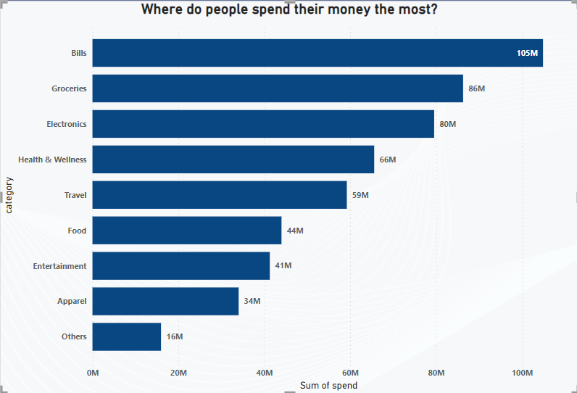
Where do people spend their money the most?
More than 72% of total spending goes to bills, electronics, groceries, health and wellness and travel. It is in these segments people spend more money into.

Slide 4
Which employees contribute to major spending?
Salaried employees solely contribute to 55 percent of the total spending. Business owners and the salaried employees contribute to more than 75% of total spending. It is optimal to focus on salaried employees, business owners and freelancers as they contribute to a major chunk of spending. The government employees contribute to least spending when it comes to even the credit card spending.

Slide 5
Who spends more on an average? Men or Women
Women spend lesser than men from this sample dataset of 4000 customers. The average spending of women is 50 to 60 rupees lesser than men.
Average of spend | Column Labels
Row Labels | Married | Single | Grand Total
Female | 590.2244229 | 501.6786309 | 573.3735844
Male | 657.8765394 | 565.6009368 | 636.6641656
Grand Total | 633.3699053 | 545.8471686 | 614.4649942

Slide 6
Which age groups contribute to major spending?
The age groups of 25 to 45 contribute to more than 75% of spending. It is optimal for Mitron bank to focus on credit card marketing schemes towards these ages.

Slide 7
Which city has the highest average spend?
Mumbai, Delhi and Bengaluru has the highest average spend. Their share of average of spending is 70% and contributes to major chunk of consumer spending among the sample dataset of 4000 customers.

Slide 8
Which city has the highest income utilization percentage?
Mumbai, Delhi and Bengaluru have the highest income utilization score of more than 250. Hence, it is optimal to target the customers from these cities for more credit cards.

Slide 9
Which occupation has the highest income utilization percentage?
The salaried employees and the freelancers have the highest income utilization percentage. In terms of income utilization, the freelancers have a higher score than the business owners. This is because Freelancers have a greater need to separate their personal and business expenses. And they look out for credit cards that can be used solely for their business purposes.

Slide 10
Which category attracts the highest income utilization?
Bills, Groceries, Electronics, health and wellness are the categories that enjoy the highest income utilization above 30.

Slide 11
Which month enjoyed a higher income utilization percentage?
The months August, September and October attracted the highest income utilization percentage as the festival seasons and pre-festival shopping occurs during this time, where customers do their bulk purchases.

Slide 12
Which payment type had the highest income utilization percentage?
Credit card and UPI have the highest income utilization followed by Debit card for these customers. This is because of the increased penetration of UPI apps and credit cards by customers for multiple options like EMI. The usage of debit card is a bit lower as customers in India use debit card when their UPIs don't work. Net banking has the least income utilization percentage as the increased usage of UPI has minimized the usage of internet banking by customers often for the convenience.

Slide 13
Credit Card Recommendations
A Statista research of Jan 2021 and Jan 2022 states that more Indian customers are looking out for contactless payment options even in credit cards. The contactless transactions grew by 6x in 2021 compared to 2018.
Indians tend to be attracted to credit cards that offer lucrative rewards, such as cashback, discounts on dining, travel perks, and fuel rewards. According to RBI data, reward points played a significant role in increasing credit card usage in recent years.
Heightened security measures like two-factor authentication, fraud alerts, and enhanced encryption are critical. A study by PwC India highlights that security concerns often deter credit card usage.

Slide 14
Credit card recommendations
Tailoring offers and benefits based on spending patterns and lifestyle choices can make credit cards more appealing. Offering personalized deals or discounts at preferred retailers or for specific spending categories can drive usage.
Indians are often sensitive to fees. Credit cards with minimal or waived annual fees tend to attract more users, as per a report by CRISIL Research.
Educating consumers about the responsible use of credit cards and their benefits can also positively impact usage. Programs and resources that promote financial literacy can encourage more individuals to use credit cards.

Slide 15
THANK YOU

